Slide 1
Number Systems
Lecture 2 – Intro to Info. & Comm. Technologies

Slide 2
Number Systems
Number System Name | Number System and Description
Decimal Number System | 🡪Base 10 🡪Digits used: 0 to 9
Binary Number System | 🡪Base 2 🡪Digits used : 0, 1
Octal Number System | 🡪Base 8. 🡪Digits used : 0 to 7
Hexadecimal Number System | 🡪Base 16. 🡪Digits used: 0 to 9, Letters used : A- F

Slide 3
Binary Number System
Each digit of a binary number is called a bit. For example the number (1010)₂ has 4 bits.
The more the number of bits, the more the total numbers that can be represented. For example if we use 8 bits, then total numbers that can be represented by 8 bits is 2⁸=256.

Slide 4
Binary Number System (contd)
Suppose we have 8 bits. We know that we can store 256 numbers in these 8 bits.
If we store only positive numbers, then the smallest number that we can store is 0, and the largest number that we can store is 2⁸-1= 255.
0 in binary (using 8 bits) is (00000000)₂ and 255 in binary is (11111111)₂

Slide 5
How to compute the decimal value of a binary number
Technique
Multiply each bit by 2^{n}, where n is the position of the digit. So, 2^{n} is the value of the bit.
The weight is the position of the bit, starting from 0 on the right
Add the results

Slide 6
How to compute the decimal value of a binary number
Example
Binary Number: 10101
Calculating Decimal Equivalent:
Step | Binary Number | Decimal Number
Step 1 | 10101 | (1 x 2⁴) + (0 x 2³) + (1 x 2²) + (0 x 2¹) + (1 x 2⁰)
Step 2 | 10101 | 16 + 0 + 4 + 0 + 1
Step 3 | 10101 | 21

Slide 7
How to compute the decimal value of a binary number (shortcut)
Suppose we want to find the decimal value of binary number 10101011.
128 | 64 | 32 | 16 | 8 | 4 | 2 | 1
1 | 0 | 1 | 0 | 1 | 0 | 1 | 1
Simply add the decimal values where the corresponding bit is 1.

Slide 8
Hexadecimal Number System
The hexadecimal number system has 16 digits. 0, 1, 2, 3, 4, 5, 6, 7, 8, 9, A, B, C, D, E, F
Examples of hexadecimal numbers:
1F
1AB
100
54

Slide 9
How to compute the decimal value of a hexadecimal number
Technique
Multiply each digit by 16^{n}, where n is the position of the digit. So, 16^{n} is the value of the digit.
positions of the bit start from 0 on the right
Add the results

Slide 10
How to compute the decimal value of a hexadecimal number
Step | Hex Number | Decimal Number
Step 1 | 19FDE | (1 x 16⁴) + (9 x 16³) + (F x 16²) + (D x 16¹) + (E x 16⁰)
Step 2 | 19FDE | (1 x 16⁴) + (9 x 16³) + (15 x 16²) +(13 x 16¹) + (14 x 16⁰)
Step 3 | 19FDE | 65536+ 36864 + 3840 + 208 + 14
Step 4 | 19FDE | 106462

Slide 11
Decimal Number Systems
One of the most common number systems.
Has 10 digits: 0, 1, 2, 3, 4, 5, 6, 7, 8, 9

Slide 12
Decimal to Binary
Technique
Divide by two, keep track of the remainder
125₁₀ = ?₂
2 125 62 1
2 31 0
2 15 1
2 7 1
2 3 1
2 1 1
125₁₀ = 1111101₂

Slide 13
Decimal to Hexadecimal
1234₁₀ = ?₁₆
16 1234
77 2
16
4 13 = D
16
0 4
1234₁₀ = 4D2₁₆

Slide 14
Converting Hexadecimal to Binary and Vice Versa

Slide 15
Hexadecimal to Binary
We know that the largest digit in hexadecimal is F, and this digit requires 4 bits for binary representation.
So, find 4-digit binary value of each hexadecimal digit.
The binary equivalent of the hexadecimal number is simply the concatenation of 4-digit binary values of all digits in order.

Slide 16
Conversion Chart
Decimal | Binary | Hex
00 | 0000 | 0
01 | 0001 | 1
02 | 0010 | 2
03 | 0011 | 3
04 | 0100 | 4
05 | 0101 | 5
06 | 0110 | 6
07 | 0111 | 7
08 | 1000 | 8
09 | 1001 | 9
10 | 1010 | A
11 | 1011 | B
12 | 1100 | C
13 | 1101 | D
14 | 1110 | E
15 | 1111 | F

Slide 17
Hexadecimal to Binary
Example
10AF₁₆ = ?₂
1 0 A F
0001 0000 1010 1111
10AF₁₆ = 0001000010101111₂

Slide 18
Binary to Hexadecimal
Make Quadruplets of bits from right to left.
Find the hexadecimal value of each quadruplet.
The final hexadecimal number is the concatenation of hex digits in order.

Slide 19
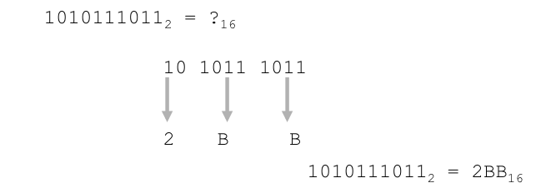
Binary to Hexadecimal
Example:

Slide 20
Representing Signed Binary Numbers in Computer Memory

Slide 21
Signed Magnitude Representation
Signed binary numbers can be represented in computer memory by using the most significant bit as a signed bit. This representation is also called sign & magnitude representation.
If the signed bit is on, the number is negative, and if the signed bit is off, the number is positive.
What is the total number of values that can be stored using this signed representation?

Slide 22
Signed Magnitude Representation
Examples:
(01101101)₂ = +(109)₁₀
(11101101)₂ = -(109)₁₀
(00101011)₂ = +(43)₁₀
(10101011)₂ = -(43)₁₀

Slide 23
Signed Magnitude Representation
Range of values for positive number:
1 to 127
Range of values for negative numbers:
-127 to -1.
Problem:
Positive zero and negative zero.
So, The range for positive numbers becomes +0 to +127, and for negative numbers the range becomes
-127 to -0.

Slide 24
Converting a Binary Number Represented by Signed Magnitude into Decimal.
Suppose there are N bits in the given binary number represented by signed magnitude form. The most significant bit will be used to represent the sign.
Simply find the decimal equivalent of remaining N-1 bits, and put – sign if the sign bit is 1 else put +.
Example: (11010001)
Find the decimal of (1010001) which is 81. Since the sign bit is 1, so the number is -81.

Slide 25
1’s Complement
To represent a negative number in 1’s complement, first find its positive binary counterpart.
Then inverse the bits.
For example: Represent -2 using 1 byte in 1’s complement.
2= 00000010
-2= 11111101
Note: Applying 1’s complement again on the binary of a negative number (represented by 1’s complement) will convert it into the positive number.

Slide 26
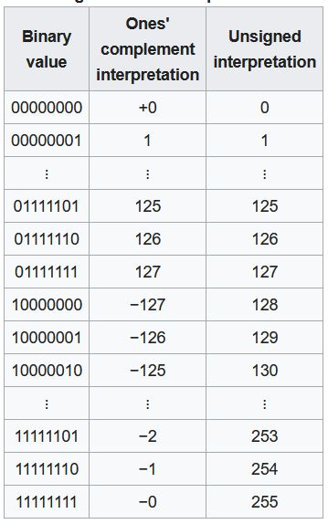

Slide 27
Range of 1’s Complement Representation
The range of signed numbers using one‘s complement is −(2^{N−1} − 1) to (2^{N−1} − 1) with ±0.
For example: if we use 8 bits, then range is −127₁₀ to +127₁₀ with zero being either 00000000 (+0) or 11111111 (−0).

Slide 28
Converting a Binary Number Represented by 1’s Complement into Decimal.
Suppose there are N bits in the given binary number represented by 1’s complement.
If the most significant bit is 0, then the number is positive, and simply find its decimal equivalent.
If the most significant bit is 1, then the number is negative. So, first apply 1’s complement (to convert the negative binary number into positive binary number), then find the decimal equivalent and put – sign.
Example: (11010011)
Finding 1’s complement since msb is 1: 00101100.
Now find the decimal equivalent: 44
Put negative sign. (-44)

Slide 29
2’s complement
First find 1’s complement.
Now add 1 to the 1’s complement.
It does not have positive and negative zero problem.
For example: Represent -2 using 1 byte in 2’s complement.
2= 00000010
1’s complement = 11111101
2’s complement= 11111101+1= 11111110
-2= 11111110
Note:
Applying 2’s complement again on the binary of a negative number (represented by 2’s complement) will convert it into the binary of the same positive number. For example, apply 2’s complement on the binary of -2 (calculated above) and see the result.

Slide 30
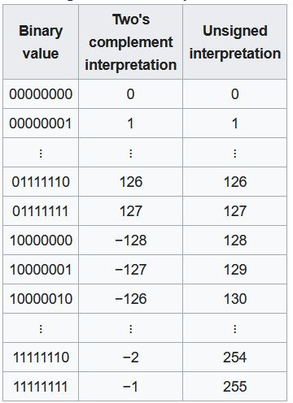

Slide 31
Range of 2’s Complement Representation
The range of signed numbers using two's complement is −(2^{N−1} ) to (2^{N−1} − 1). There is only one representation of 0 in this representation.
For example: if we use 8 bits, then range is −128₁₀ to +127₁₀ with zero being 00000000.

Slide 32
Converting a Binary Number Represented by 2’s Complement into Decimal.
Suppose there are N bits in the given binary number represented by 2’s complement.
If the most significant bit is 0, then number is positive and simply find its decimal equivalent.
If the most significant bit is 1, then number is negative. So, first apply 2’s complement (to convert it into positive binary number), then find the decimal equivalent of positive binary number and put – sign.
Example: (11010011)
Finding 2’s complement since msb is 1: 00101101.
Now find the decimal equivalent: 45
Put negative sign. (-45)

Slide 33
Data Representation in Computers

Slide 34
What is Data
Data is simply
any numbers, letters or symbols that can be entered into a computer system.
Data values don’t have any meaning unless we put them into context
Information = Data + Context

Slide 35
Computers Process Data
Computers are used to process all types of information in a broad spectrum fields.
Numeric data consisting of Integers and real numbers are used in programs calculating payroll. We typically perform arithmetic operations on numeric data.
Strings of alphabets and numbers (Alphanumeric Data) are processed in customer record keeping systems.
Multimedia content including images, sound and text are frequently used in a large collection of application areas.
Signals representing various types of information like temperature, pressure, presence or absence of objects etc. are processed by computers in Robotics, IoT, monitoring and control applications.

Slide 36
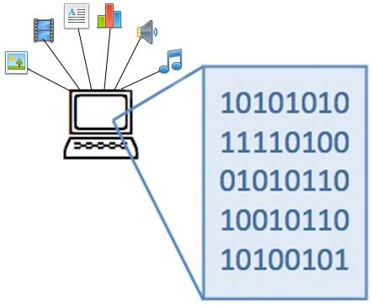
How is Data Actually Stored in Computer
Everything that is stored and processed inside a computer
(all data, information, instructions, files, images, etc.) is stored as Binary Numbers
Digital computers have been made such that all data and instructions(program) for processing must be stored in computers memory before processing.

Slide 37
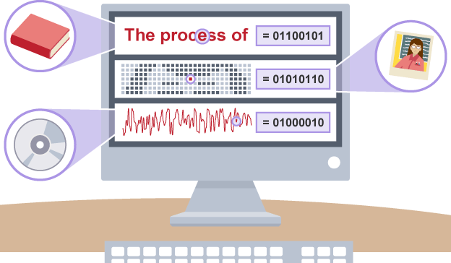
How to store text and pictures as numbers?
The solution is to use numeric codes:
Different letters in a text document are given different numeric codes
Different pixels (colored dots) in an image are given different numeric codes
Different sounds in a music file are given different numeric codes
Everything is numbers!

Slide 38
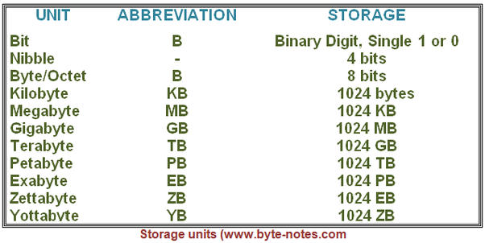
Memory Measuring Units (As viewed by computer scientists)
Bits can be grouped together to make them easier to work with. A group of 8 bits is called a byte.
Most computers can process millions of bits every second. A hard drive's storage capacity is measured in gigabytes or terabytes. RAM is often measured in megabytes or gigabytes.

Slide 39
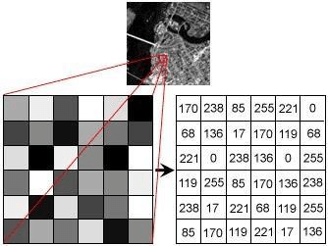
How Images are Stored in Memory

Slide 40

0 | 0 | 255 | 0 | 0
0 | 0 | 255 | 0 | 0
0 | 0 | 255 | 0 | 0
255 | 255 | 255 | 255 | 255
0 | 0 | 255 | 0 | 0
0 | 0 | 255 | 0 | 0
0 | 0 | 255 | 0 | 0

Slide 41
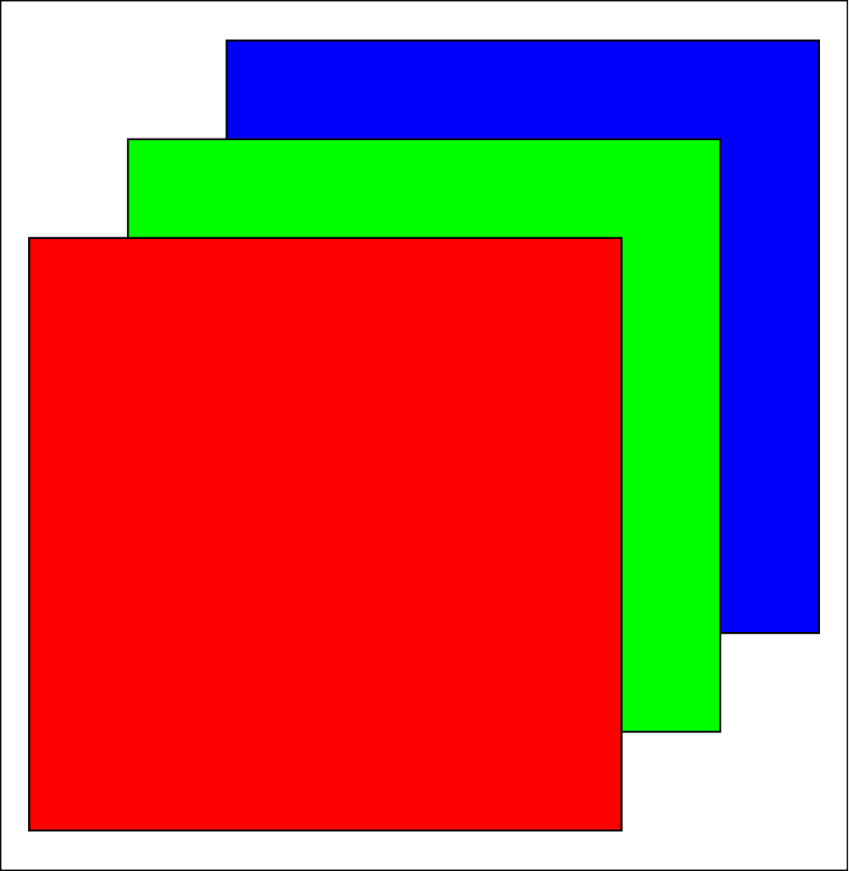
How To Represent Color Images in Memory
RGB
Three Separate Matrices for R, G and B, respectively.

Slide 42
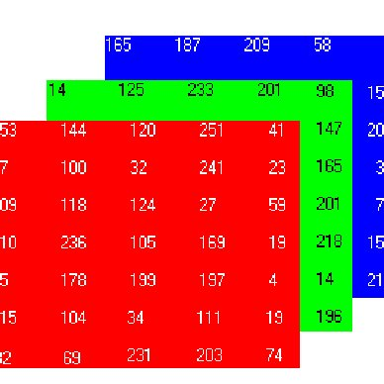
How To Represent Color Images in Memory

Slide 43
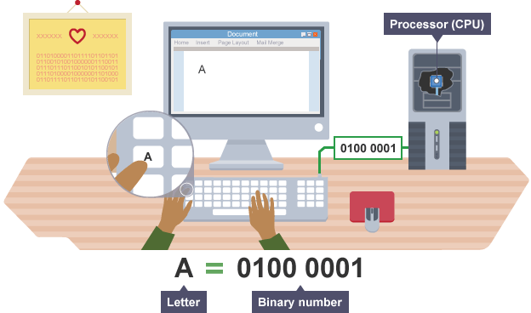
How can we represent a character?
IDEA.
Assign numeric codes to characters and represent each character in a Byte using it’s numeric code.
Can we assign numeric codes of our choice to each character?. What might be a problem with this approach?

Slide 44
How can we represent a character?
IDEA
Create a Standard coding scheme so that information can be easily shared between devices from different vendors.
Standard Codes
ASCII (American Standard Code for Information Interchange)
Unicode
Unicode Transformation Format(UTF) UTF-8, UTF-16
ANSI Character Set

Slide 45
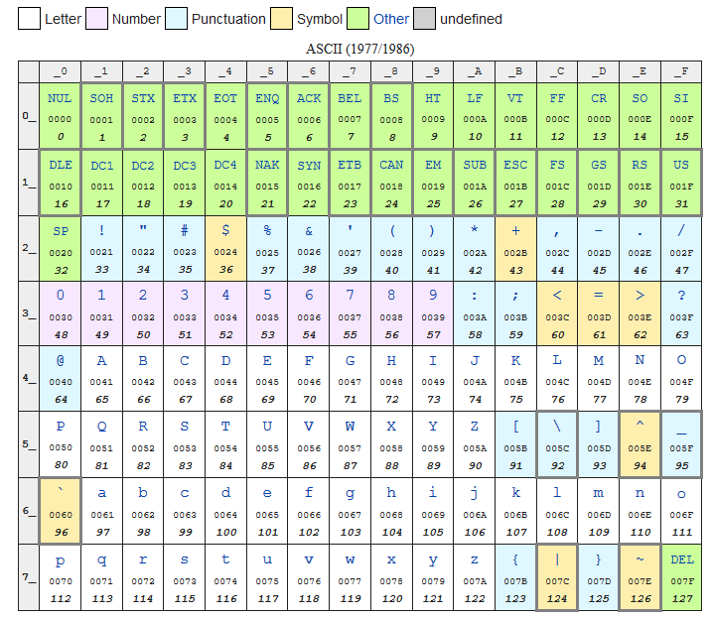
ASCII Character Encoding

Slide 46
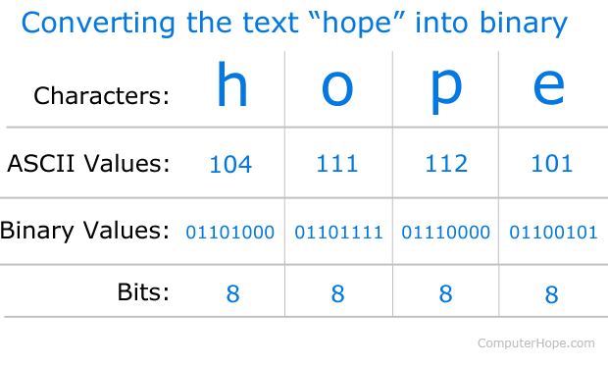
ASCII to Binary 0s and 1s

Slide 47
Recommended
https://www.youtube.com/watch?v=1GSjbWt0c9M
https://www.khanacademy.org/computing/computer-science/how-computers-work2/v/khan-academy-and-codeorg-introducing-how-computers-work
https://www.youtube.com/watch?v=ptzGI9VaZmQ

Slide 48
Activity

